Slide 1

University of Waterloo
06 August, 2026
From Topology to de Rham Cohomology:
An Introduction to Smooth Manifolds and Differential Forms
Presented by
Ilmie Abeywardane
Instructed by
Jiahui Huang
Page 1 of 13

Slide 2
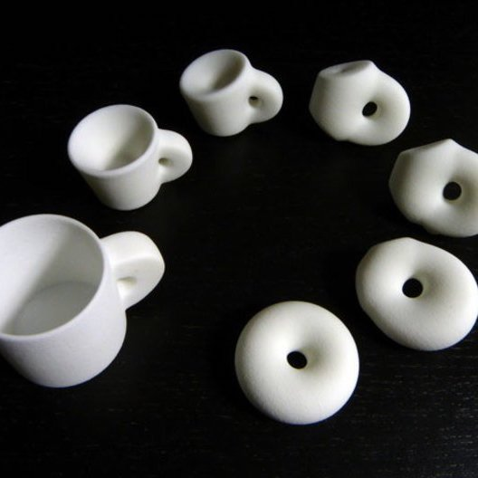
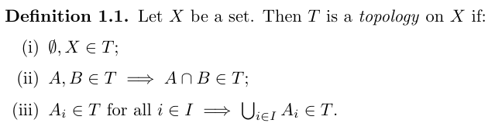
University of Waterloo
06 August, 2026
What is topology?
Topology is the study of properties of spaces that are preserved under continuous deformations, such as stretching, bending, and twisting, but not under tearing.
Page 2 of 13
Ilmie Abeywardane

Slide 3

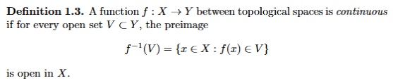
University of Waterloo
06 August, 2026
Open sets & continuity
Open sets
Continuity
Ilmie Abeywardane
Page 3 of 13

Slide 4
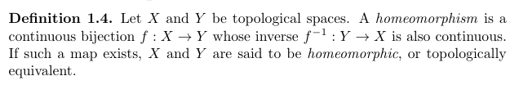
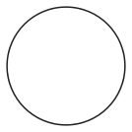
University of Waterloo
06 August, 2026
Homeomorphism
Circle is NOT homeomorphic to a line segment
Circle IS homeomorphic to a square
Ilmie Abeywardane
Page 4 of 13

Slide 5
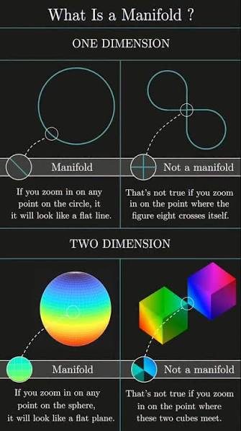
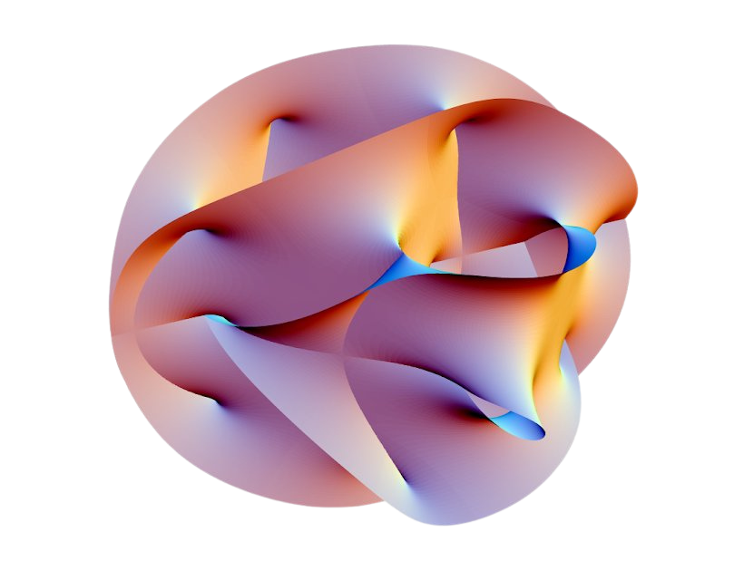
University of Waterloo
06 August, 2026
Manifolds
A manifold is a topological space that is locally homeomorphic to a Euclidean space; that is,
every point p admits an open neighbourhood that is homeomorphic to Euclidean space.
Ilmie Abeywardane
Page 5 of 13

Slide 6
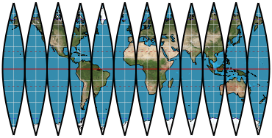
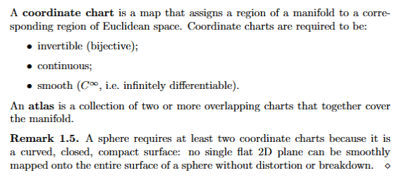
University of Waterloo
06 August, 2026
Charts and atlases
Ilmie Abeywardane
Page 6 of 13

Slide 7
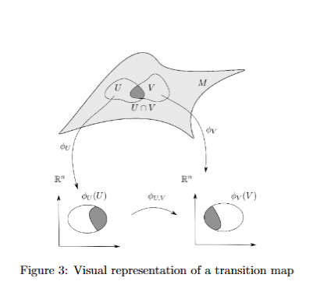
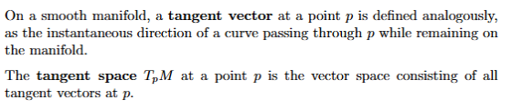
University of Waterloo
06 August, 2026
Smooth manifolds and transition maps
Ilmie Abeywardane
Page 7 of 13

Slide 8
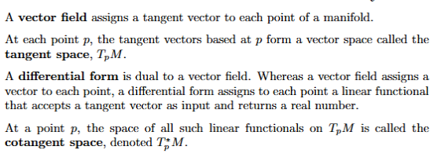
University of Waterloo
06 August, 2026
Differential forms
Ilmie Abeywardane
Page 8 of 13

Slide 9
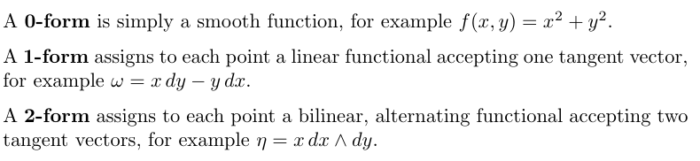
University of Waterloo
06 August, 2026
Forms by degree & the wedge product
Ilmie Abeywardane
Page 9 of 13

Slide 10
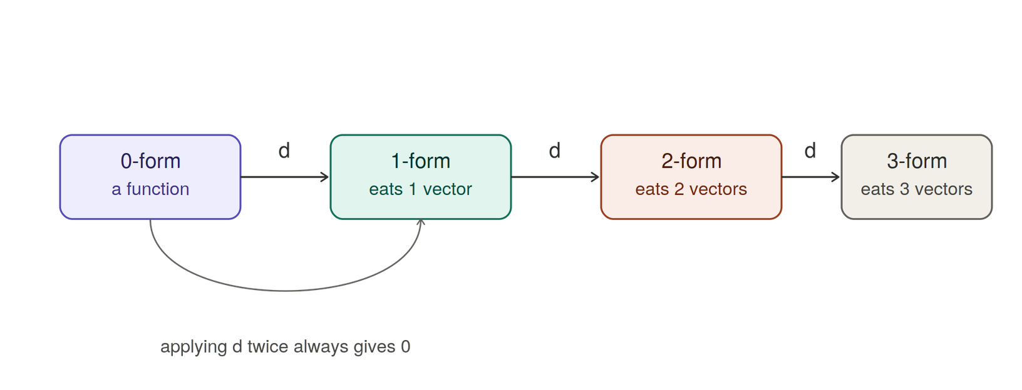
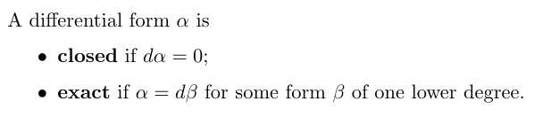
University of Waterloo
06 August, 2026
The exterior derivative
Ilmie Abeywardane
Page 10 of 13

Slide 11
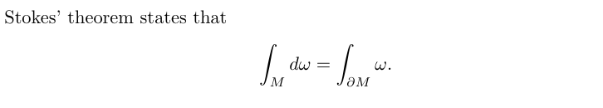
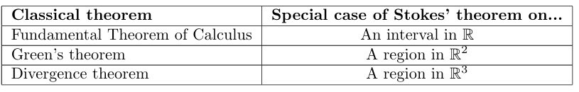
University of Waterloo
06 August, 2026
Stokes’ theorem
Series 01
Series 02
Ilmie Abeywardane
Page 11 of 13

Slide 12

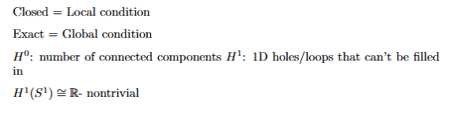
University of Waterloo
06 August, 2026
de Rham cohomology
Ilmie Abeywardane
Page 12 of 13

Slide 13


University of Waterloo
06 August, 2026
Thank
You!
Presented by
Ilmie Abeywardane
Page 13 of 13

